Slide 1

The contribution of Object detectors and vlms in
explainable social navigation
AAU Robotics mini Project November 2025

Slide 2

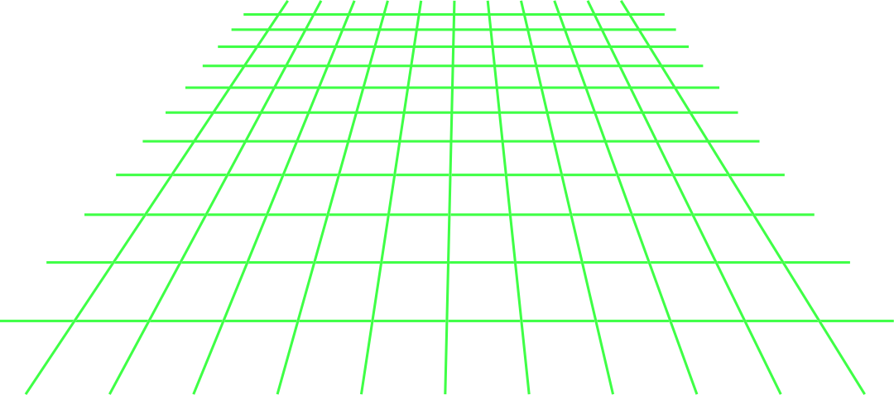
Our Team
AAU Robotics Msc University Student
AAU Robotics Msc University Student
AAU Robotics Msc University Student
Daniel Dharampal
Endri Dibra
Nicklas Deding

Slide 3

CONTENT
1
General Overview
2
Object Detectors
3
Visual Language Models
4
Path Planning
5
Implementation

Slide 4
CONTENT
6
Research topic : SmolVLA
7
Challenges
8
Limits
9
Conclusion
10
Future Scope

Slide 5

GENERAL
OVERVIEW

Slide 6
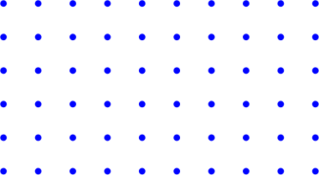
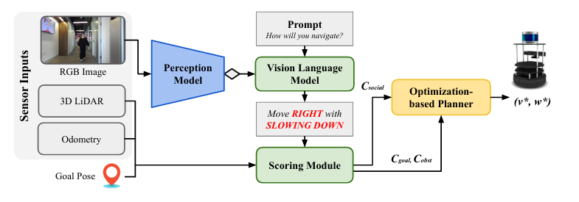
GENERAL OVERVIEW [1]
Our assigned paper to read and implement was: VLM-Social-Nav paper
They use a real mobile robot [TurtleBot] in dynamic real environments
They use Object Detectors to detect social entities such as people, obstacles, possible gestures, doors and groups
They treat the VLM [GPT-4V] as a scoring module that evaluates scene elements or candidate actions and outputs social cost information that is integrated into the path planner
They construct a social cost term and fuses it with geometric costs [distance, collision] before planning

Slide 7
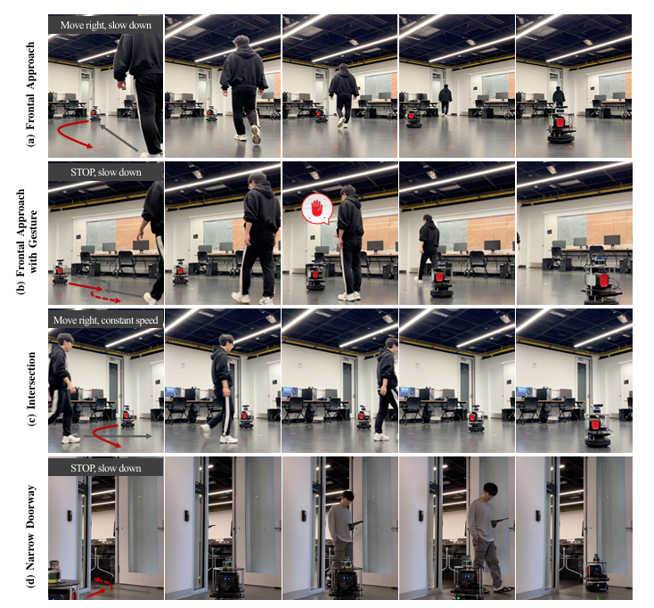
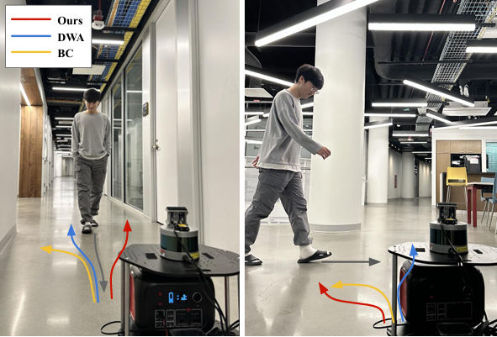
GENERAL OVERVIEW [2]

Slide 8
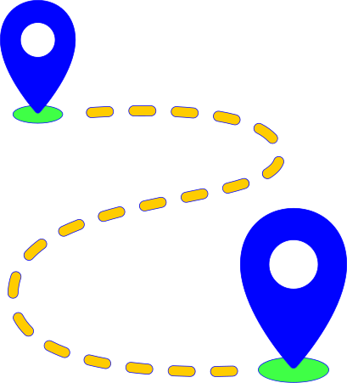
GENERAL OVERVIEW [3]
We use 2D static images for testing our algorithm. We run our object detector to detect people and obstacles and place them into bounding boxes, crop each bounding box, then send each crop to a VLM to request a per-object social threat score
the VLM is used in two ways: 1st The whole image is prompted to return four quadrant scores, and 2nd each detected object crop is prompted for a threat score. We add the social scores into the geometric cost map
We create a cost map from distance transform (inverse distance to obstacle) and add socialWeight * socialCost, [where social cost come from blended quadrant + per-object Gaussian], to that cost map. We also have curvature and turn penalties in A* and smoothing

Slide 9
ROBOTIC PERCEPTION

Slide 10
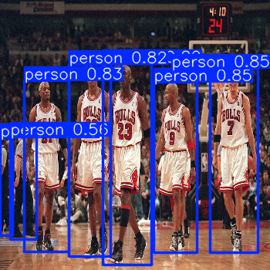
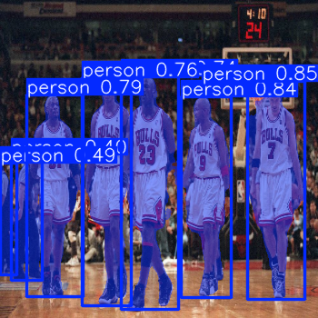

OBJECT DETECTORS
We make use of YOLOv11n developed by Ultralytics, for object detection and recognition purposes
It is lightweight
It performs in real-time cases
It is mostly correct on its predictions regarding people and objects
It can be used for segmentation purposes as well

Slide 11
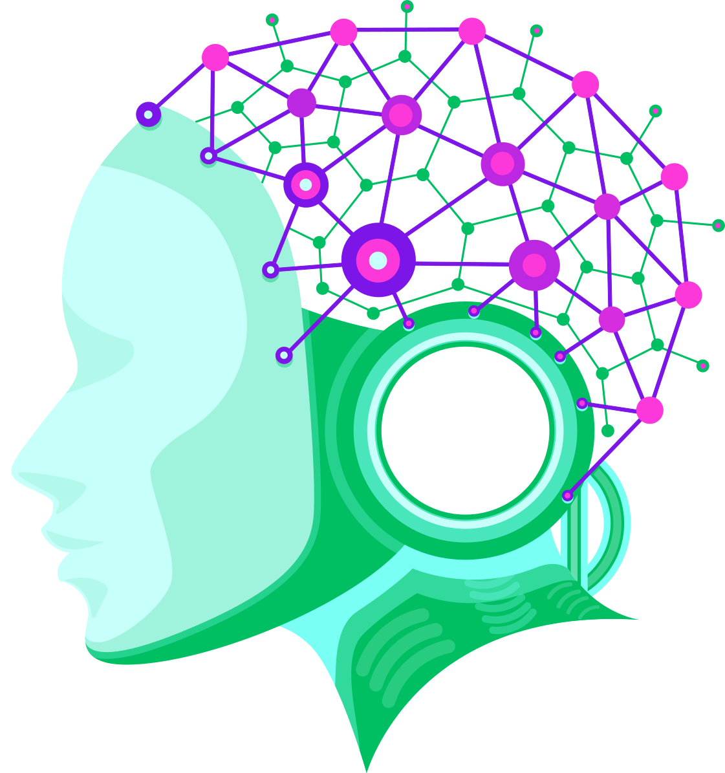
VISUAL LANGUAGE MODELS
The VLM used for this project is smolVLM - Instruct provided and developed by Hugging face
It has a size of 1.7 Billion parameters
It can be used for multimodal (image + text) tasks where the input comprises text queries along with one or more images
It is able to answer questions about images and describe visual content
For better performance it loads and runs the model in half-precision [torch.float16 or torch.bfloat16]

Slide 12

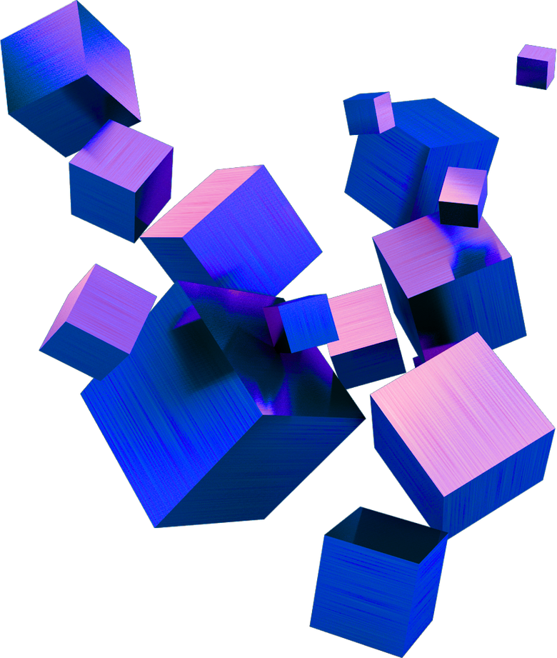
path
planning

Slide 13
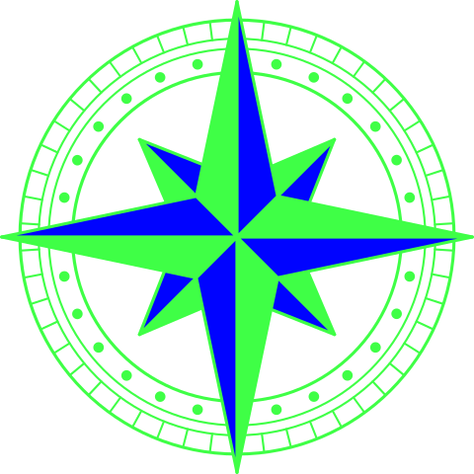
PATH PLANNING
We approach path planning using A* [A Star] algorithm, for the reason that it is a decent choice in cases like 2D static images, where the Start and Goal positions are known and there are static obstacles as well, not dynamic ones
It behaves like a global planner
Guarantees optimality, because it is able to find the optimal [least-cost] path, when its heuristic never overestimates the true cost
f(n) = g(n) + h(n)
f(n), Estimates total cost of the cheapest solution path passing through n [nodes]
g(n), Cost from the start node to n [node]
h(n), Heuristic estimate of the cost from n [node] to the goal

Slide 14
IMPLEMENTATION

Slide 15

IMPLEMENTATION [1]
We will present the implementation of our work in a flow of steps, explaining in a simple way our process and approach
First we have our original image, with no background noise, consisted of people and obstacles, to make it difficult for the A* algorithm to find an optimal path
Original Image

Slide 16
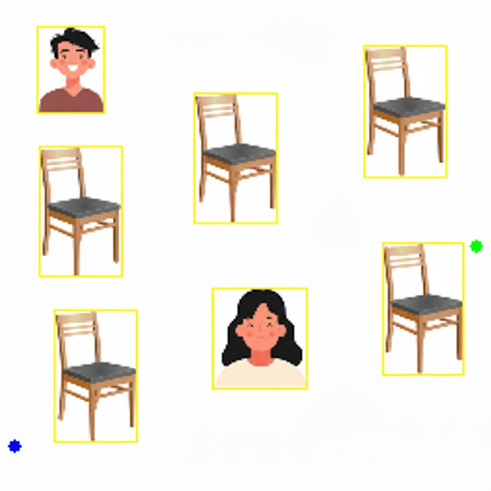
IMPLEMENTATION [2]
After that, we set up the Start [Green Dot] and Goal [Blue Dot] positions
Then, we apply people and obstacle detection through YOLOv11n model, placing them into yellow bounding boxes
The 4 walls, people and obstacles are inflated with high cost [a restrictive radius], so that the path will not touch them. People have higher cost for safety
People are multiplied with 1.0 while other obstacles with 0.3
A* has penalties for curve and turn cases, to produce a smoother path, which is pruned as well

Slide 17
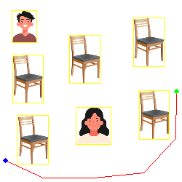
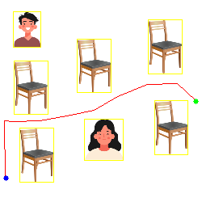
IMPLEMENTATION [3]
smolVLM steps in to provide a risk score for each feature on the image from 0 .0 to 1.0 as well as evaluating for safety the four quadrants of the image: top-left, top-right, bottom-left, bottom-right, from 0 to 1 too. This is our social cost
Cost Map = 0.6 * Social Cost + 0.4 Geometric Costs
Now is where A* algorithms and its cost map take place and start their application and sanctions
A* should find an optimal path without colliding with the features on the image, respecting social norms and choosing the shortest path to the goal

Slide 18
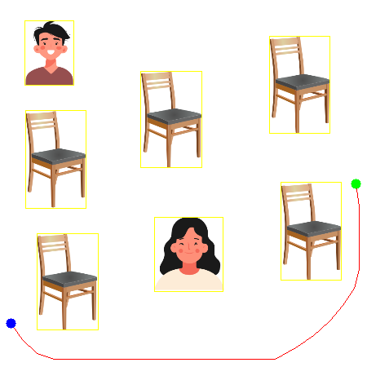
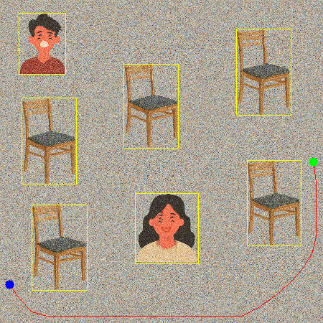
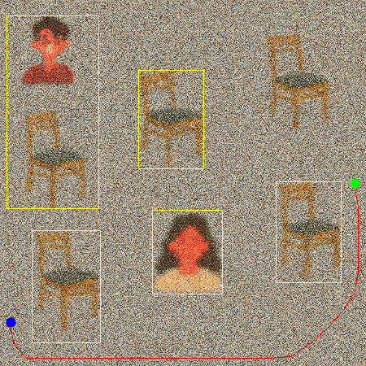
IMPLEMENTATION [4]
Testing the algorithms in light and heavy background noises, with 450 x 450 pixels resolution
Original Image
Lighter Noise
Heavier Noise

Slide 19
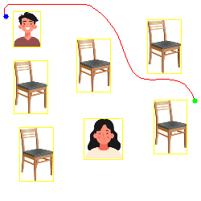
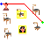
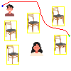
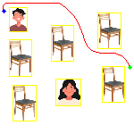
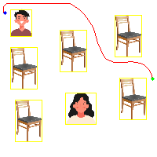
250 x 250
IMPLEMENTATION [5]
Testing the algorithms in original, light and heavy background noises, but with different size resolutions as well from 50 x 50 pixels to 250 x 250 pixels
50 x 50
100 x 100
150 x 150
200 x 200

Slide 20
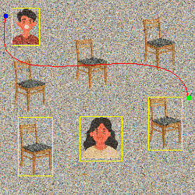
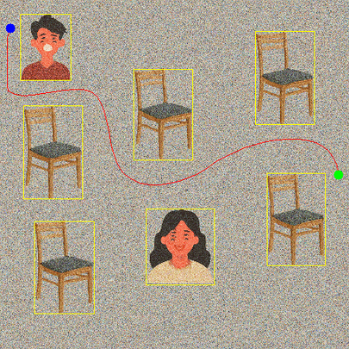
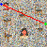
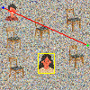
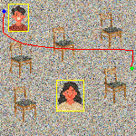
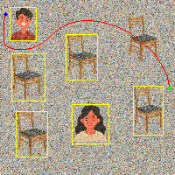
IMPLEMENTATION [6]
250 x 250
450 x 450
50 x 50
100 x 100
150 x 150
200 x 200

Slide 21
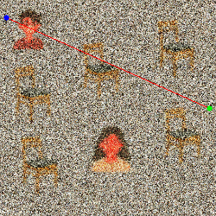
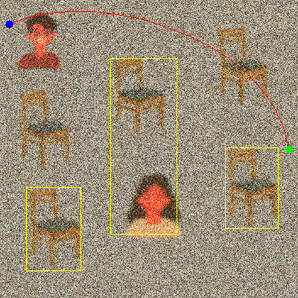
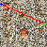
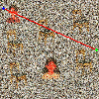
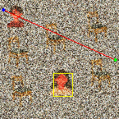
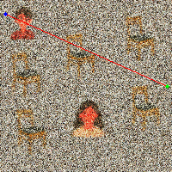
IMPLEMENTATION [7]
250 x 250
450 x 450
50 x 50
100 x 100
150 x 150
200 x 200

Slide 22
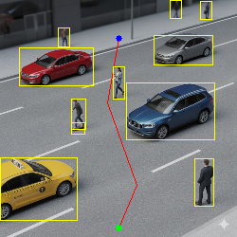
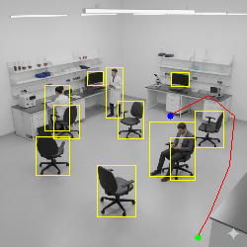
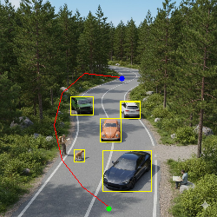
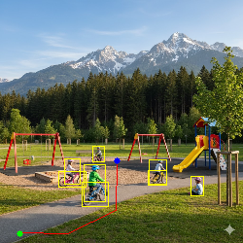
IMPLEMENTATION [8]
Testing the algorithms in different background scenes, to evaluate their robustness and generalization
Urban Road
Laboratory
Nature
Playground

Slide 23
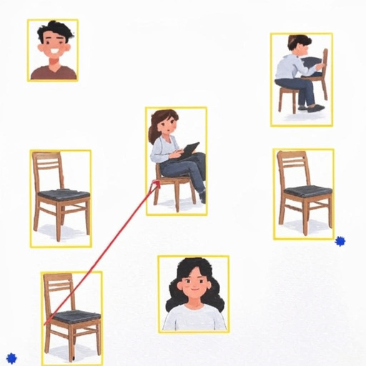
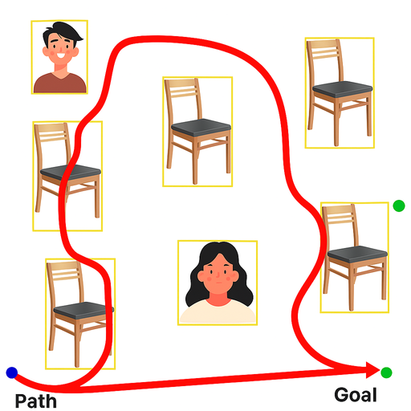
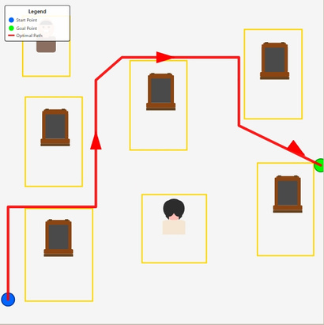
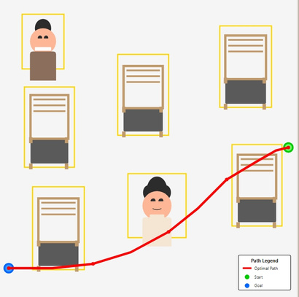
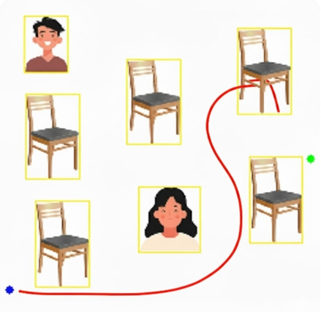
IMPLEMENTATION [9]
Grok
Finally we compare our results with other LLMs like ChatGPT-5, Gemini-2.5-Flash, Grok-4, Claude-Sonnet-4, to evaluate our design and development with strong and rich in data LLMs/VLMs
ChatGPT
Claude
Claude
Gemini

Slide 24
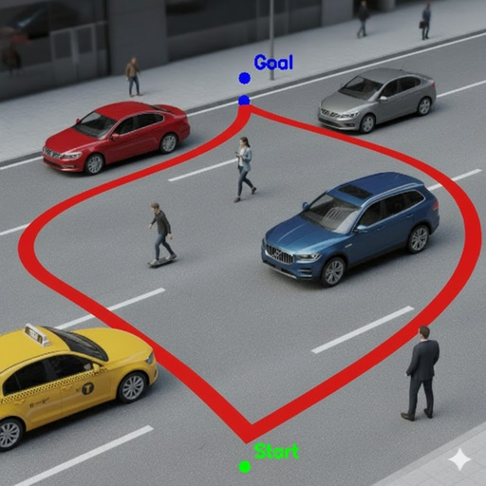
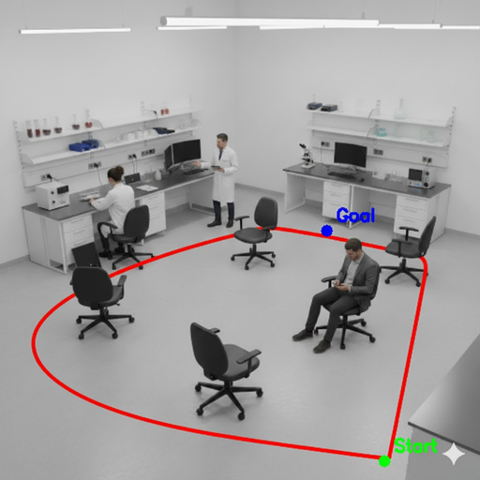
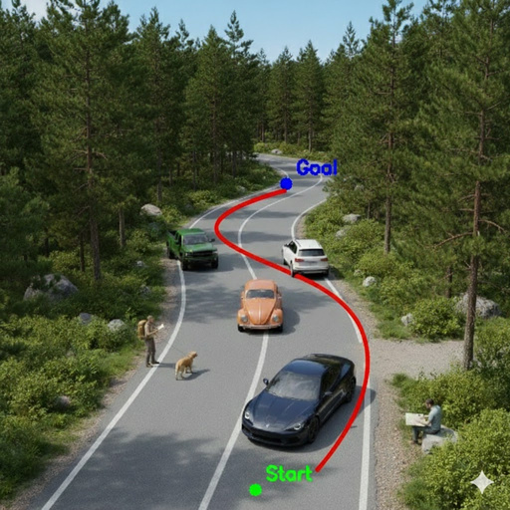
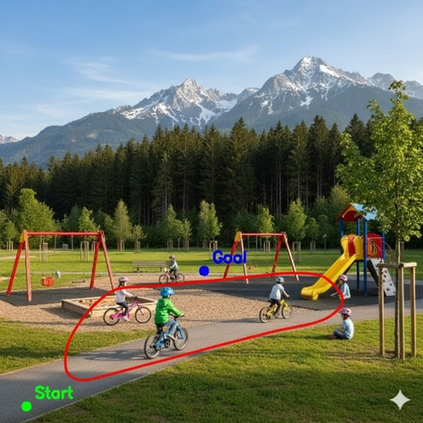
IMPLEMENTATION [10]
And comparing the images with different scenes only with Gemini
Gemini
Gemini
Gemini
Gemini

Slide 25
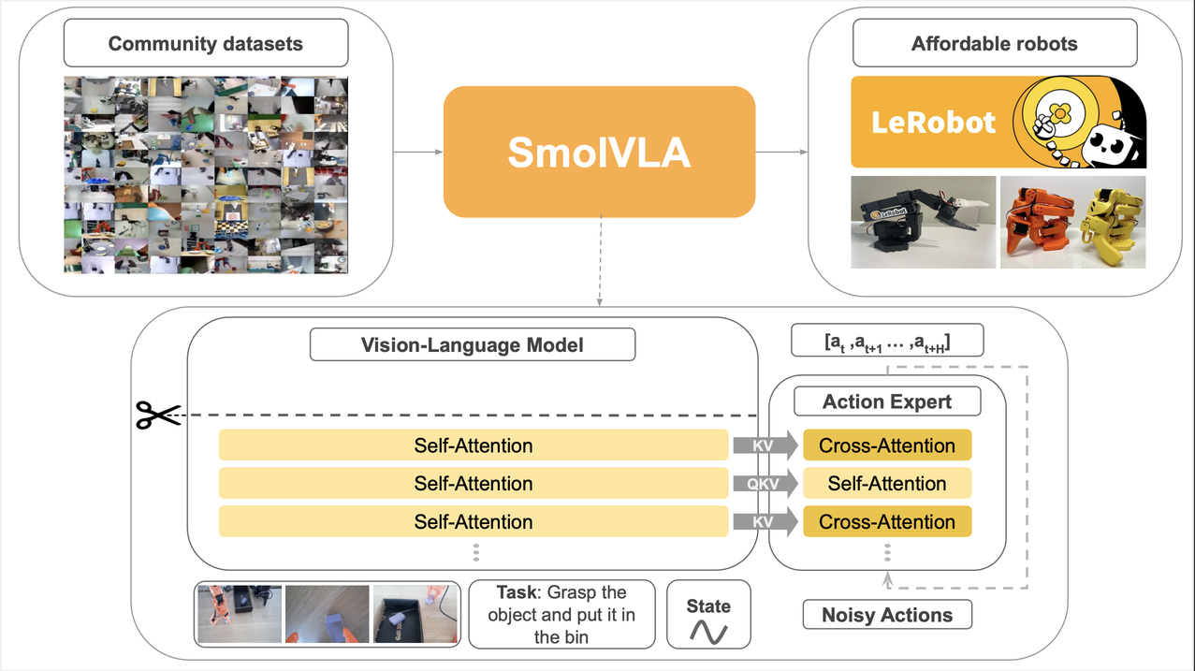
SMOLVLA [1]
smolVLA, is a Visual Language Action model
smolVLA core Architecture

Slide 26
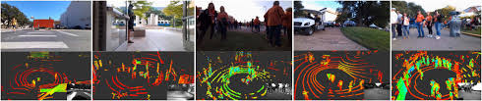
SMOLVLA [2]
Socially CompliAnt Navigation Dataset [SCAND]: Is a Large-Scale Dataset of Demonstrations for Social Navigation, used to train the higher neural layers of smolVLA

Slide 27
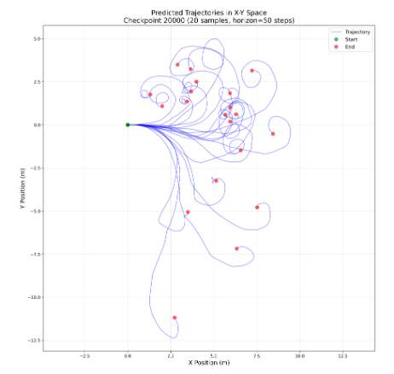

SMOLVLA [3]
smolVLA Tuning to generated the desired path with proper linear and angular velocities

Slide 28


SMOLVLA [4]
Resulted paths from training and tuning phase of smolVLA
Testing phase and results

Slide 29



CHALLENGES
Parameters Tuning
Proper Prompts
Latency Duration
Different Start - Goal Positions and Scenes/Backgrounds

Slide 30


01
02
Static 2D Images Only
Image Scaling to different sizes, ignores depth
LIMITATIONS
03
04
Real-time process, takes a couple of minutes to provide the final generated path
smolVLM limited output, because of its size

Slide 31

CONCLUSION
Ultimately, for our team this period and project have been stepping stones to understand better these technologies and their importance for a proper socially aware navigation, as well as to continue further alongside with a more robust skillset, building and executing our main group project.

Slide 32


FUTURE SCOPE
TIAGO PRO
The next step is to implement the algorithm in a real-life robot, Tiago Pro from Pal, in a 3D world scenario

Slide 33

THANK YOU !
FOR YOUR ATTENTION

